Slide 1


Most promising Game publisher Acquisition Candidates
1
Robert Smith, Emilien Beaugrand , Andrii Deviatkin, Yu Shuang Tay, Joar Ericsson

Slide 2



EXEUTIVE SUMMARY
Strategic expansion: acquiring gaming publishers
Publisher acquisition accelerates growth, creates synergies while enhancing sustainable long-term value to shareholders.
Impact: 4 Key attributes – quality, revenue, growth, engagement (in order of precedence)
Opportunity: Increase the revenue of the company and its power on the market
Risk: Integration risks (culture / governance / pipeline delivery) which may erode value and standards
1.
2.
3.
Recommendation:
2
Robert, Emilien , Andrii, Yu Shuang, Joar

Slide 3


Business context
Positioning Microsoft in a $200B Gaming Market
Publisher Acquisition
Strategic Rationale
Access to talent & pipelines
Exclusive IP portfolio
Strengthens Game Pass differentiation
Publishers may be undervalued
Industry Landscape
Competitor Behavior
- Acquired 10% of Kadokawa’s shares ($ 320 m)
- Acquisition of Insomniac Games for ($229 m)
- Acquired 15.8% of Arrowhead Game Studios shares ($ 83 m)
- Invested $1.25 b in Ubisoft subsidiary
3
Robert, Emilien , Andrii, Yu Shuang, Joar

Slide 4







KPIs
Measuring performance with game-specific KPIs
Positive reviews ratio
Review score
Semantic score
Recommendation rate
Monetising efficiency
Owner acquisition rate
Engagement ratio
4
Robert, Emilien , Andrii, Yu Shuang, Joar

Slide 5
Approach
Grouping KPIs by forming ranked categories
40%
30%
20%
10%
Quality
Revenue
Growth
Engagement
Positive reviews ratio
Review score
Semantic score
Recommendation rate
Monetizing efficiency
Owner acquisition rate
Engagement ratio
5
Robert, Emilien , Andrii, Yu Shuang, Joar

Slide 6
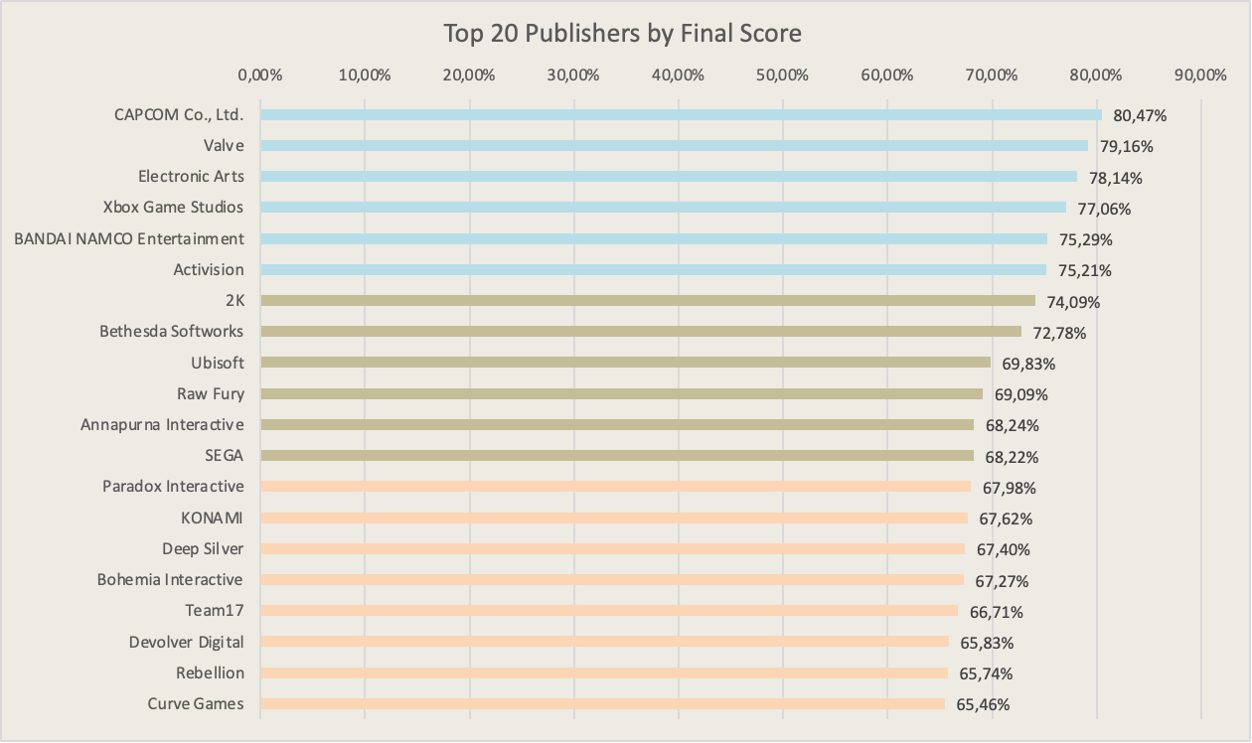
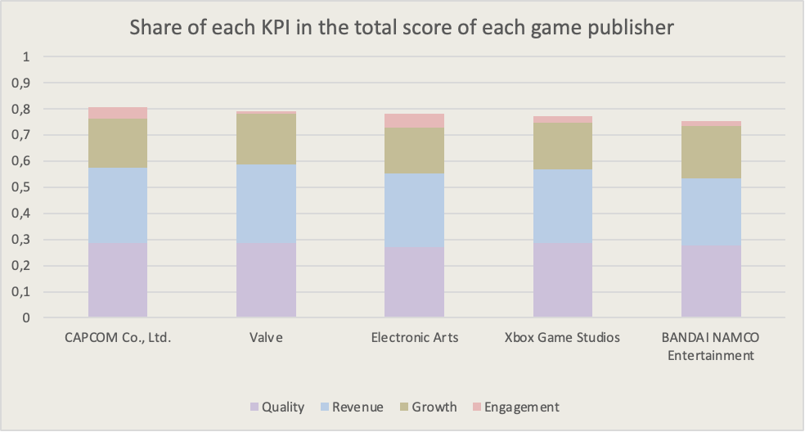
KEY FINDINGS
Translating KPIs to identify top publishers
Top 3 Publishers :
H
6
Robert, Emilien , Andrii, Yu Shuang, Joar

Slide 7
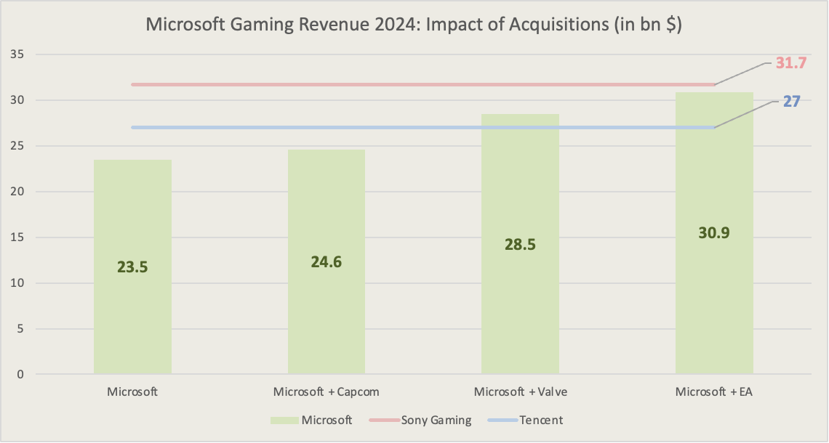
Significant increase in Microsoft’s market share in the video game industry
Strengthened market power and competitive positioning
Substantial growth in gaming revenues
Achieving parity with Microsoft’s biggest competitors, such as Sony Gaming
STRATEGIC IMPACT
The potential financial impact of key acquisitions
7
Robert, Emilien , Andrii, Yu Shuang, Joar

Slide 8
RECOMMENDATIONS
Top publishers with roadmap for acquisition
Capcom
Trades mainly on the Japanese Stock Exchange
Market Cap of 10 € billion
Valve
Privately owned - Gabe Newell largest shareholder
Estimated to be worth around 14 € Billion
Electronic Arts
Trades mainly on the Nasdaq Stock Exchange
Market Cap of 37 € Billion
01
02
03
Engage Investment Bank Advisors
Structure Financing Strategy
Initiate Acquisition Approach
8
Robert, Emilien , Andrii, Yu Shuang, Joar

Slide 9
Appendix & References
9

Slide 10
Key Assumptions:
Average Owners – since the real owners' amount is not available, we used the average from the owners' range
The data provides only the users' yesterday (30.10.2024) we assume these numbers as the average daily amount of users overall
Demo versions were excluded as they were not released and did not collect enough data from users
We considered only publishers with 20+ games, as smaller ones were largely generic or had broken names due to data inaccuracies
To improve data quality, we removed spaces and converted all publisher names to lowercase during grouping, ensuring that misspelled entries were still grouped together.
10

Slide 11
KPI Description:
KPI | Category | Formula | Initial measurement unit | Initial range | Normalisartion type | Description
Positive Reviews Ratio | Quality | positive reviews / total amount of review | percentage | 0 to 1 | linear | Share of positive reviews review score
Review Score | Quality | information in the data | categorical points | 0 to 9 | linear | AVG rating provided by users
Semantic Score | Quality | information in the data | range of value | -1 to 1 | logarithmic | LLM analysis of review text to capture tone beyond ratings
Recommendation Rate | Quality | number of recommendation/ average owner | percentage | 0 to 1 | logarithmic | Share of users who recommended the game
Monetizing Efficiency | Revenue | average owners* price | euros | 0 to ≈ 4.5 billion | logarithmic | Revenue generated per active Owner
Owner Acquisition Rate | Growth | average owner/ number of day since released | people per day | 0 to ≈ 2000 | logarithmic | Rate at which users buy the game
Engagement ratio | Engagement | concurent users yesterday / average owners | percentage | 0 to 1 | linear | Level of user involvement
11

Slide 12
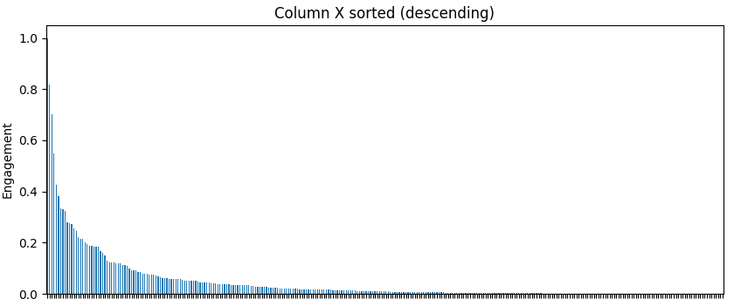
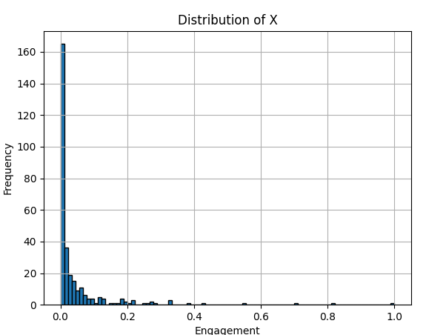
Statistics:
Publishers normalised and sorted by Engagement
12

Slide 13
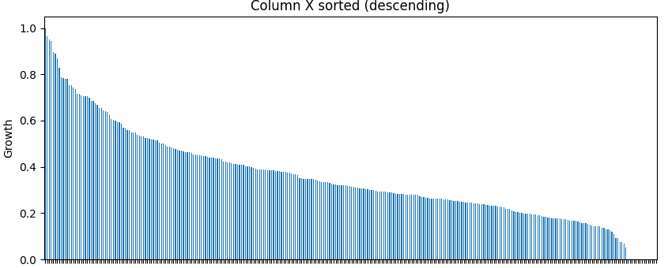
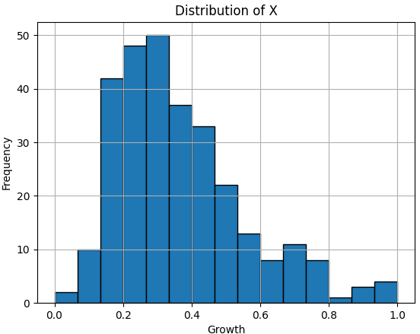
Statistics:
Publishers normalised and sorted by Growth
13

Slide 14
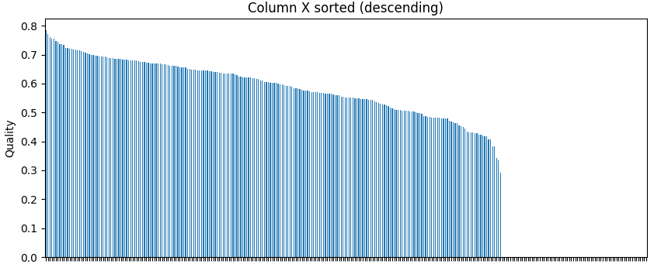
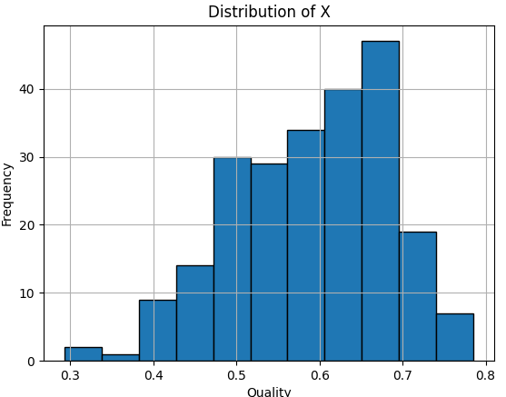
Statistics:
Publishers normalised and sorted by Quality
14

Slide 15
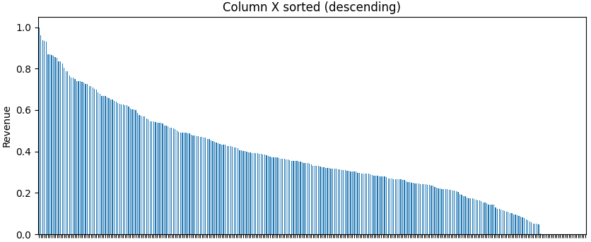
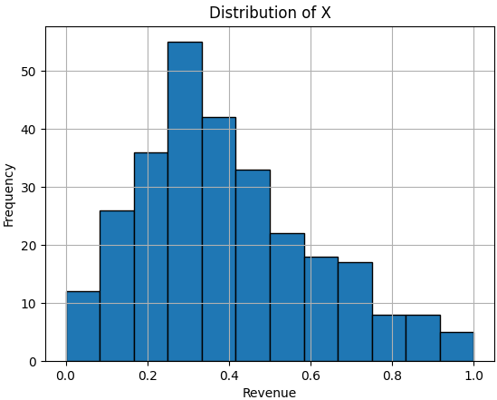
Statistics:
Publishers normalised and sorted by Revenue
15

Slide 16
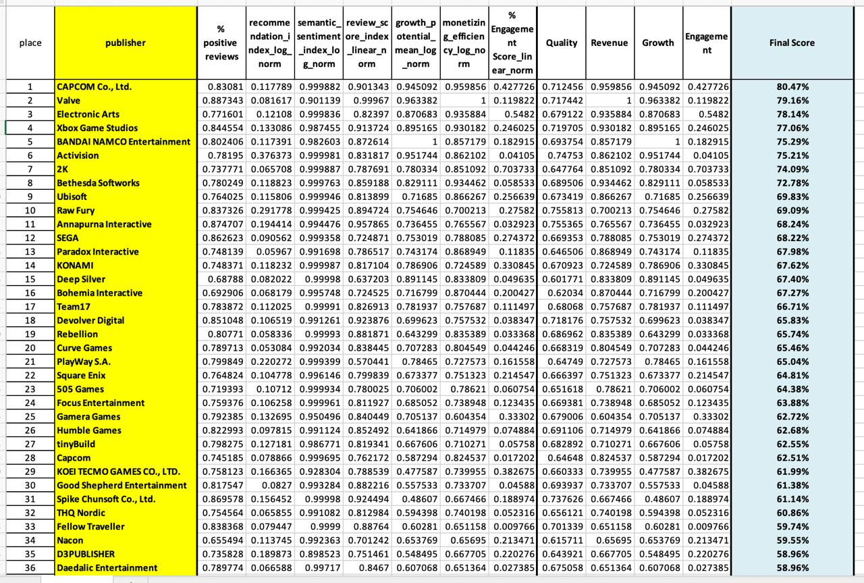
Final score Preview:
* For the original Excel file with these Data please check scorring_merged_Winners.xlsx
16

Slide 17
References
Brief history of Sony’s M&A deals: how PlayStation brought together 20+ first-party studios | Game World Observer. (2023, April 21). Game World Observer. https://gameworldobserver.com/2023/04/21/sony-acquisitions-playstation-studios-20-teams-sie
Capcom (9697.T) - Market capitalization. (n.d.). https://companiesmarketcap.com/capcom/marketcap/
CapCom (9697.T) - revenue. (n.d.). https://companiesmarketcap.com/capcom/revenue/
Client challenge. (n.d.). https://www.ft.com/content/49a3b309-939b-4530-9d37-ee21b13a462c
Electronic Arts (EA) - Market capitalization. (n.d.). https://companiesmarketcap.com/electronic-arts/marketcap/
Electronic Arts (EA) - revenue. (n.d.). https://companiesmarketcap.com/electronic-arts/revenue/
Elliott, R. (2024, December 16). PlayStation’s financial results: The good, the bad, and the hopeful. MIDiA Research. https://www.midiaresearch.com/blog/why-playstations-earnings-point-to-strategy-learnings-short-term-growth-challenges-and-brighter-horizons
Hagedoorn, H (2024, May 23) Microsoft Reportedly Readies $16 Billion Bid to Acquire Valve / Steam
https://www.guru3d.com/story/microsoft-reportedly-readies-billion-bid-to-acquire-valve-steam/
Knezovic, A. (2025, August 7). Gaming Industry Report 2025: Market Size & Trends. Udonis Mobile Marketing Agency. https://www.blog.udonis.co/mobile-marketing/mobile-games/gaming-industry
17

Slide 18
Strickland, D. (2024, December 20). Sony Kadokawa acquisition is off, Sony buys 10% of company shares instead. TweakTown. Retrieved August 25, 2025, from https://www.tweaktown.com/news/102244/sony-kadokawa-acquisition-is-off-buys-10-of-company-shares-instead/index.html
Wu, J., & Wu, J. (2025, March 20). Tencent’s evergreen games signal high player engagement but lack of new IPs. TechNode. https://technode.com/2025/03/20/tencents-evergreen-games-signal-high-player-engagement-but-lack-of-new-ips/#:~:text=In%202024%2C%20Tencent's%20online%20gaming,two%20million%20daily%20active%20users
Valve Revenue and Growth Statistics (2024) - SignHouse. (2024, August 1). SignHouse. https://usesignhouse.com/blog/valve-stats/
18

